Slide 1

Predicting Breast Cancer using machine learning

Slide 2
Machine Learning??
Machine learning (ML) is the scientific study of algorithms and statistical models that computer systems use to perform a specific task without using explicit instructions, relying on patterns and inference instead.
Machine Learning can be simply termed to be experiments that a computer does on data sets for further predictions.

Slide 3
Abstract
In this project, a performance comparison between different machine learning algorithms such as, Support Vector Machine (SVM), Decision Tree, Naive Bayes (NB) and k Nearest Neighbours (k-NN) on the Breast_cancer dataset is conducted.
The main objective is to assess the correctness in classifying data with respect to efficiency and effectiveness of each algorithm in terms of accuracy, sensitivity and specificity. Experimental results show that kNN gives the highest accuracy (97.13%) with lowest error rate. All experiments are executed using Jupyter Notebook with Anaconda 3(64-bit) as the Base.

Slide 4
Line Of Action:
Importing Libraries
Importing Datasets
Split dataset into attributes using iloc
Splitting dataset into train and test dataset
Training and Prediction
Evaluating the Algorithm

Slide 5
Importing Libraries and Dataset

Slide 7
ERROR 404:
NO NULL VALUES FOUND

Slide 8
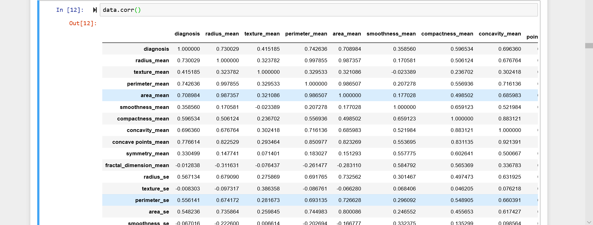
Correlation

Slide 9
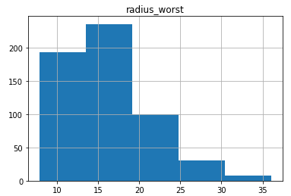
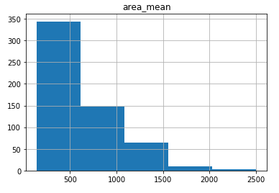
DATA VISUALISATION Histograms:-

Slide 10
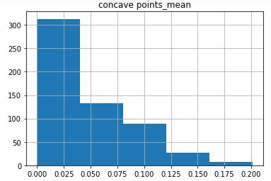
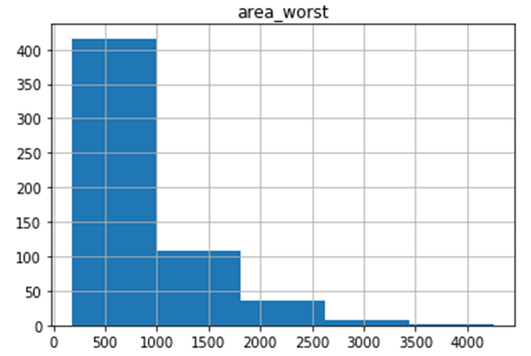

Slide 11
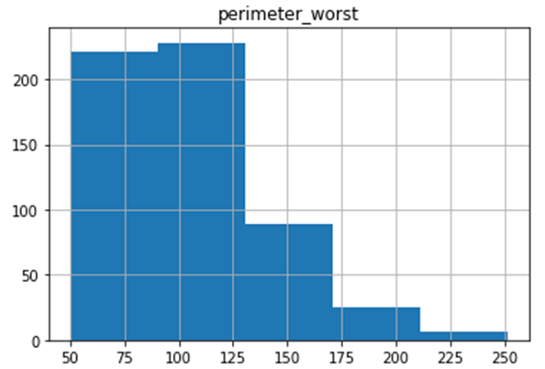
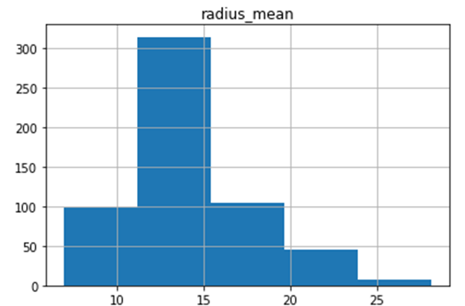

Slide 12
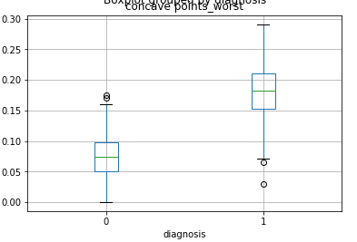
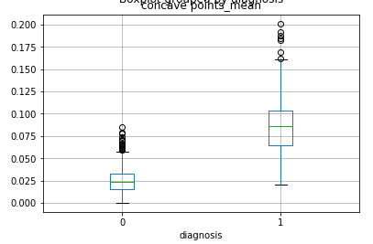
BoxPlots:-

Slide 13
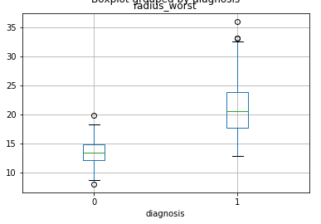
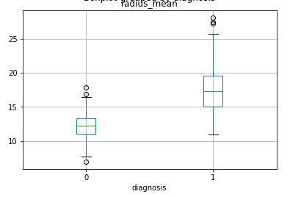

Slide 14
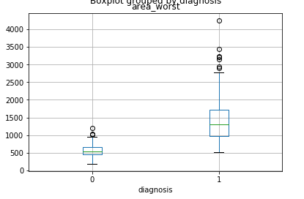
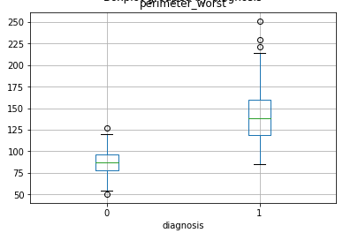

Slide 15
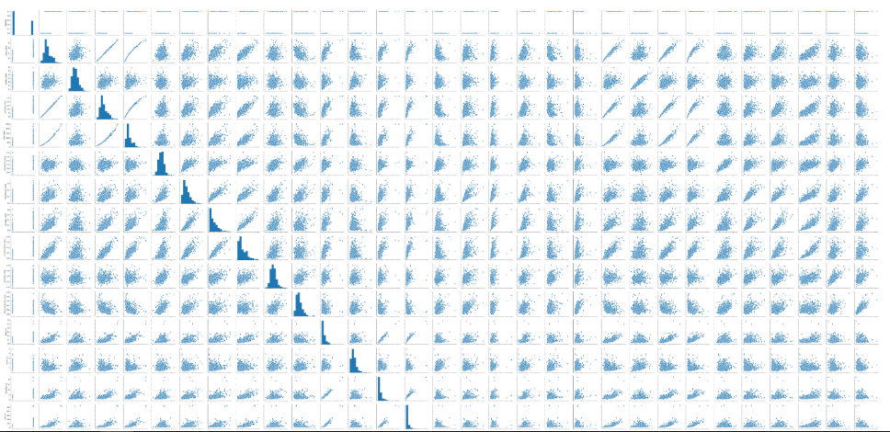
Pair plots

Slide 16
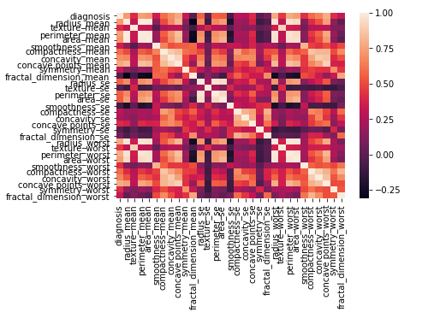
Heatmap

Slide 17

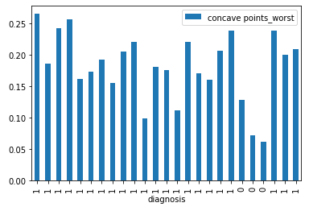
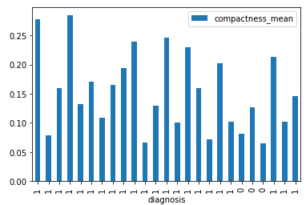
Bar graphs

Slide 18


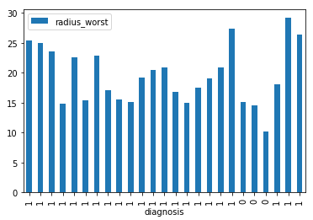
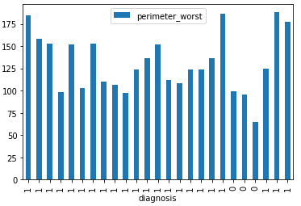

Slide 19
Splitting Attributes
USING iloc

Slide 21
splitting Dataset into Training and Testing.

Slide 23
Why did we choose all the Attributes as Predictors?

Slide 24
We choose all the attributes as predictors because
All the attributes given are at a good correlation with diagnosis of breast cancer
These values are from cancer reports.
\.

Slide 25
Training & prediction
Let’s start with the first set of slides

Slide 26
S. No | Algorithms | Accuracy1
1 | Logistic Regression | Train - 94%
 |  | Test – 92%
2 | Decision Tree | Train – 100%
 |  | Test – 88%
3 | Random Forest | Train – 99%
 |  | Test – 93%
4 | Support Vector Classification | Train – 100%
 |  | Test – 58%
5 | Naive Bayes | Train – 94%
 |  | Test – 92%
6 | K- Nearest Neighbours | Train – 94%
 |  | Test – 93%

Slide 27
Evaluating the Algorithm

Slide 28
For KNN
Data Splitting | Train(%) | Test(%) | Accuracy(%)
90-10 | 95 | 89 | 89
80-20 | 94 | 93 | 93
70-30 | 93 | 94 | 94
60-40 | 93 | 95 | 95
50-50 | 94 | 93 | 93

Slide 29
Precision and Recall
Precision | Recall
91.6% | 93.6%

Slide 30
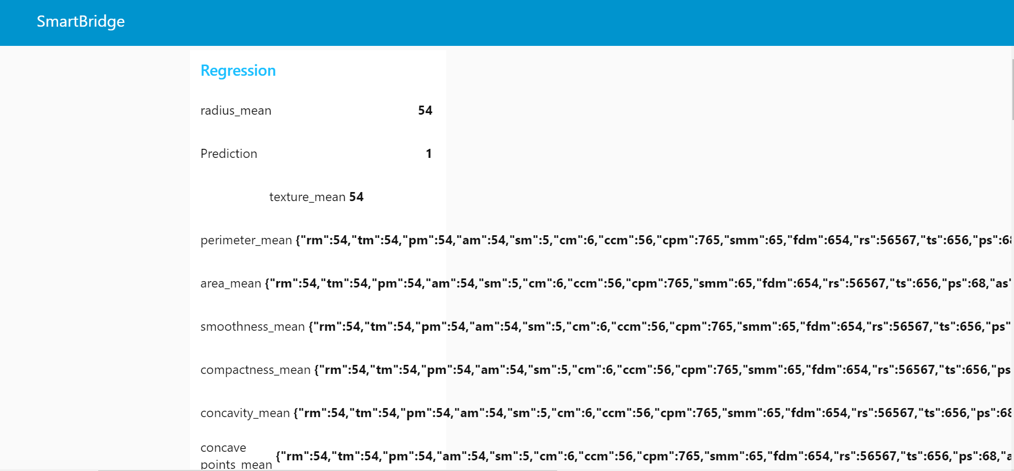
Results

Slide 31
Thank You
Team COSMOS

Slide 32

Work by Team Cosmos
Madhuri
Sahil Shaik
Vamsi Krishna
Sai Kiran
Sarath Reddy

